Slide 1

AI Based Image Classifier
Name: ASHA S R
Roll No: 2214100645
Program: BACHELOR OF COMPUTER APPLICATIONS (BCA)
Semester: VI
Session: March 2024
Date: 10 December 2024

Slide 2



Agenda
Introduction
Technologies used:
Data flow diagram(DFD)
Control Flow Diagram (CFD)
Entity Relationship Diagram (ERD)
Project Pages
Future Scope
Conclusion

Slide 3
Introduction to AI Based Image Classifier
AI Based Image Classifier:
Web-based application designed to classify images uploaded by users.
Utilizes the power of machine learning
MobileNetV2 model is used
provides accurate predictions for a wide range of image categories.
Built with a user-friendly interface, allowing users to easily upload images, view predictions, and manage their previous predictions.

Slide 4
Technologies used:
Python
HTML
SQLite
MobileNetV2
Unit Test Framework

Slide 5
Data flow diagram(DFD)
User
Image Upload
Prediction Database
Image Prediction
Manage Prediction

Slide 6
Control Flow Diagram (CFD)
Start
Image Upload
Image Prediction
Manage Predictions
View Predictions
Delete Predictions
End
End

Slide 7
Entity Relationship Diagram (ERD)
User
UserID (PK)
Username
Password
Email
Image
ImageID (PK)
UserID (FK)
ImagePath
UploadDate
Prediction
PredictionID (PK)
ImageID (FK)
PredictionResult
ConfidenceScore
PredictionDate

Slide 8
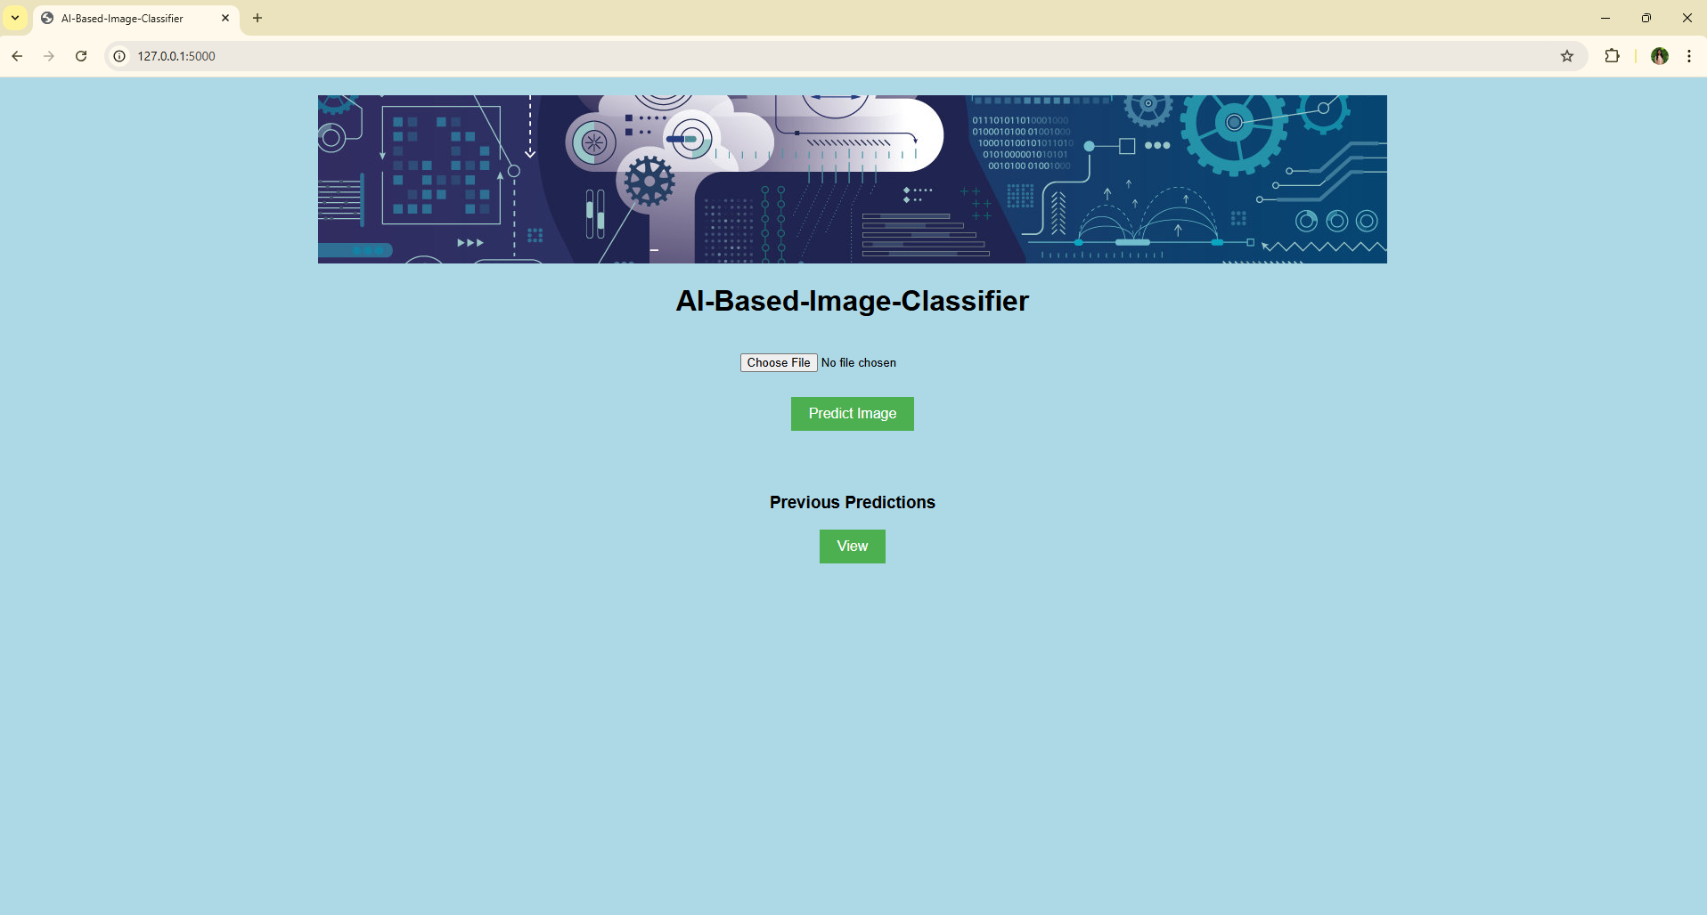
Project Pages: Home Page

Slide 9
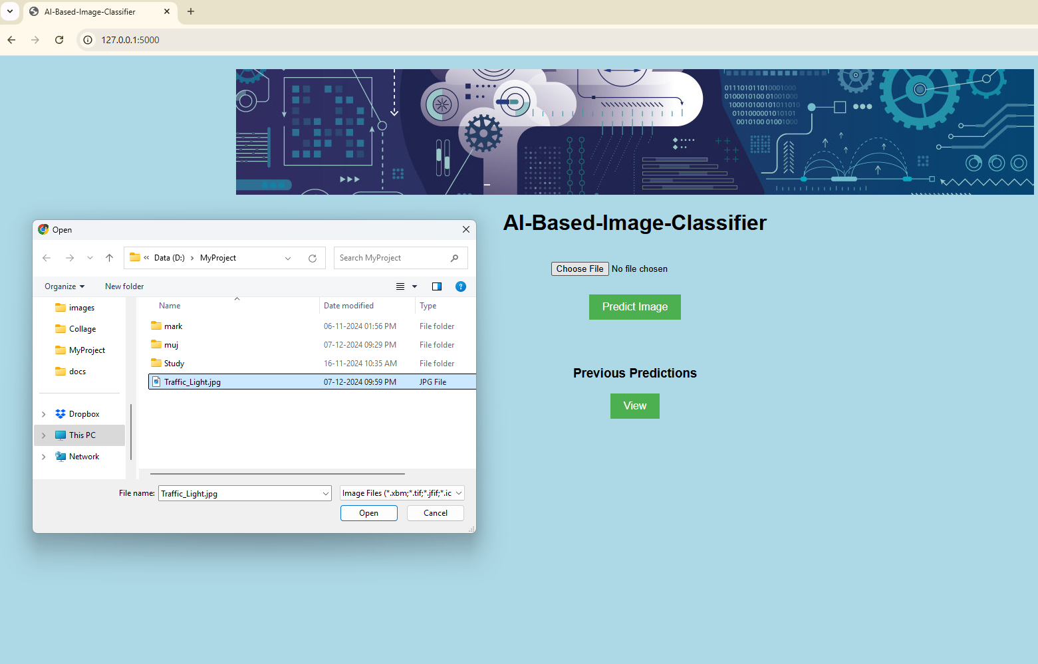
Project Pages: Choose Image File

Slide 10
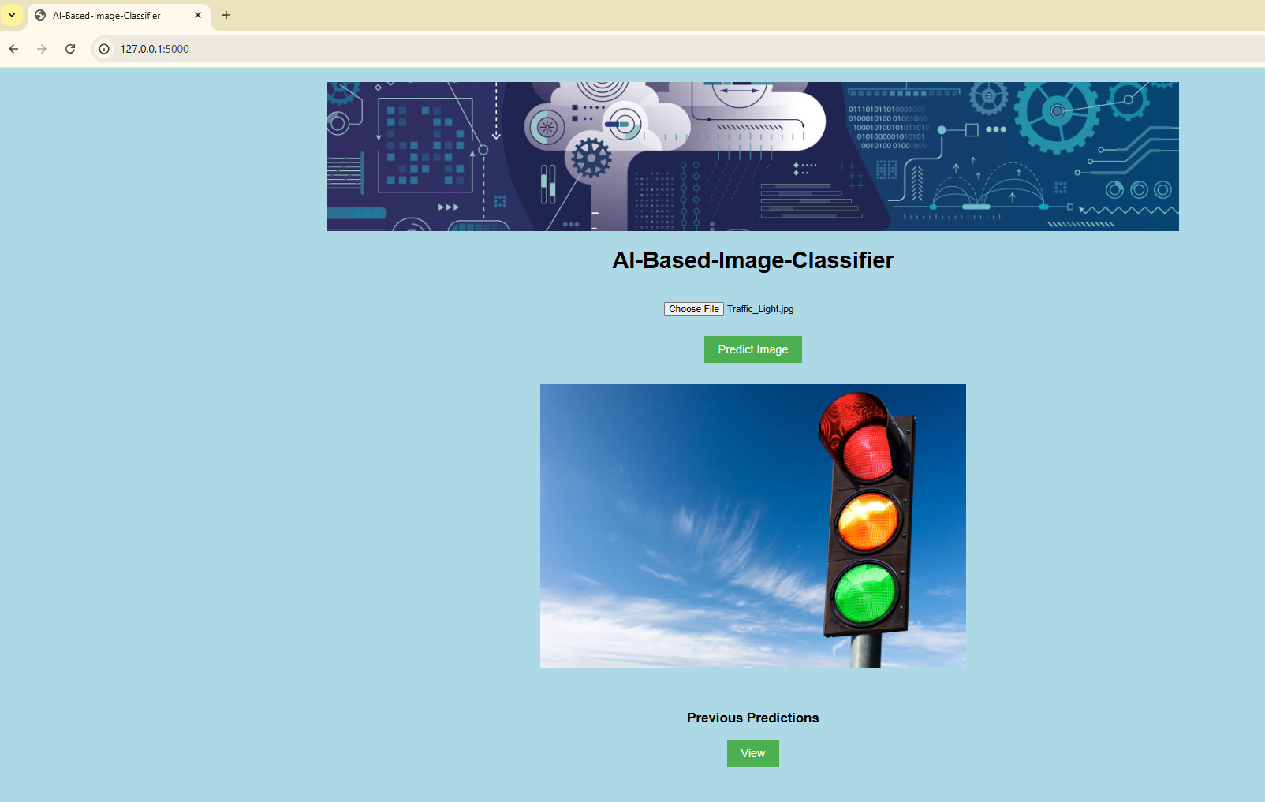
Project Pages: Image Upload Done

Slide 11
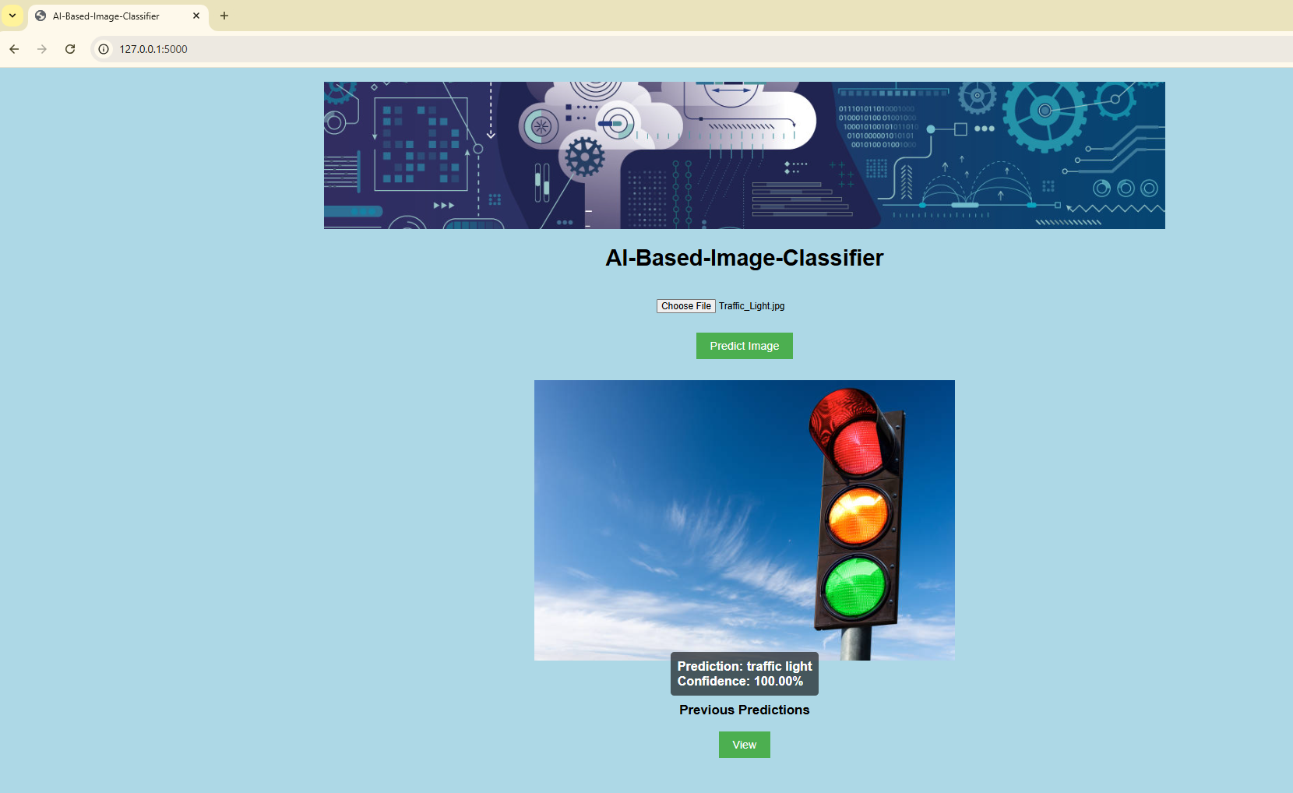
Project Pages: Prediction Result

Slide 12
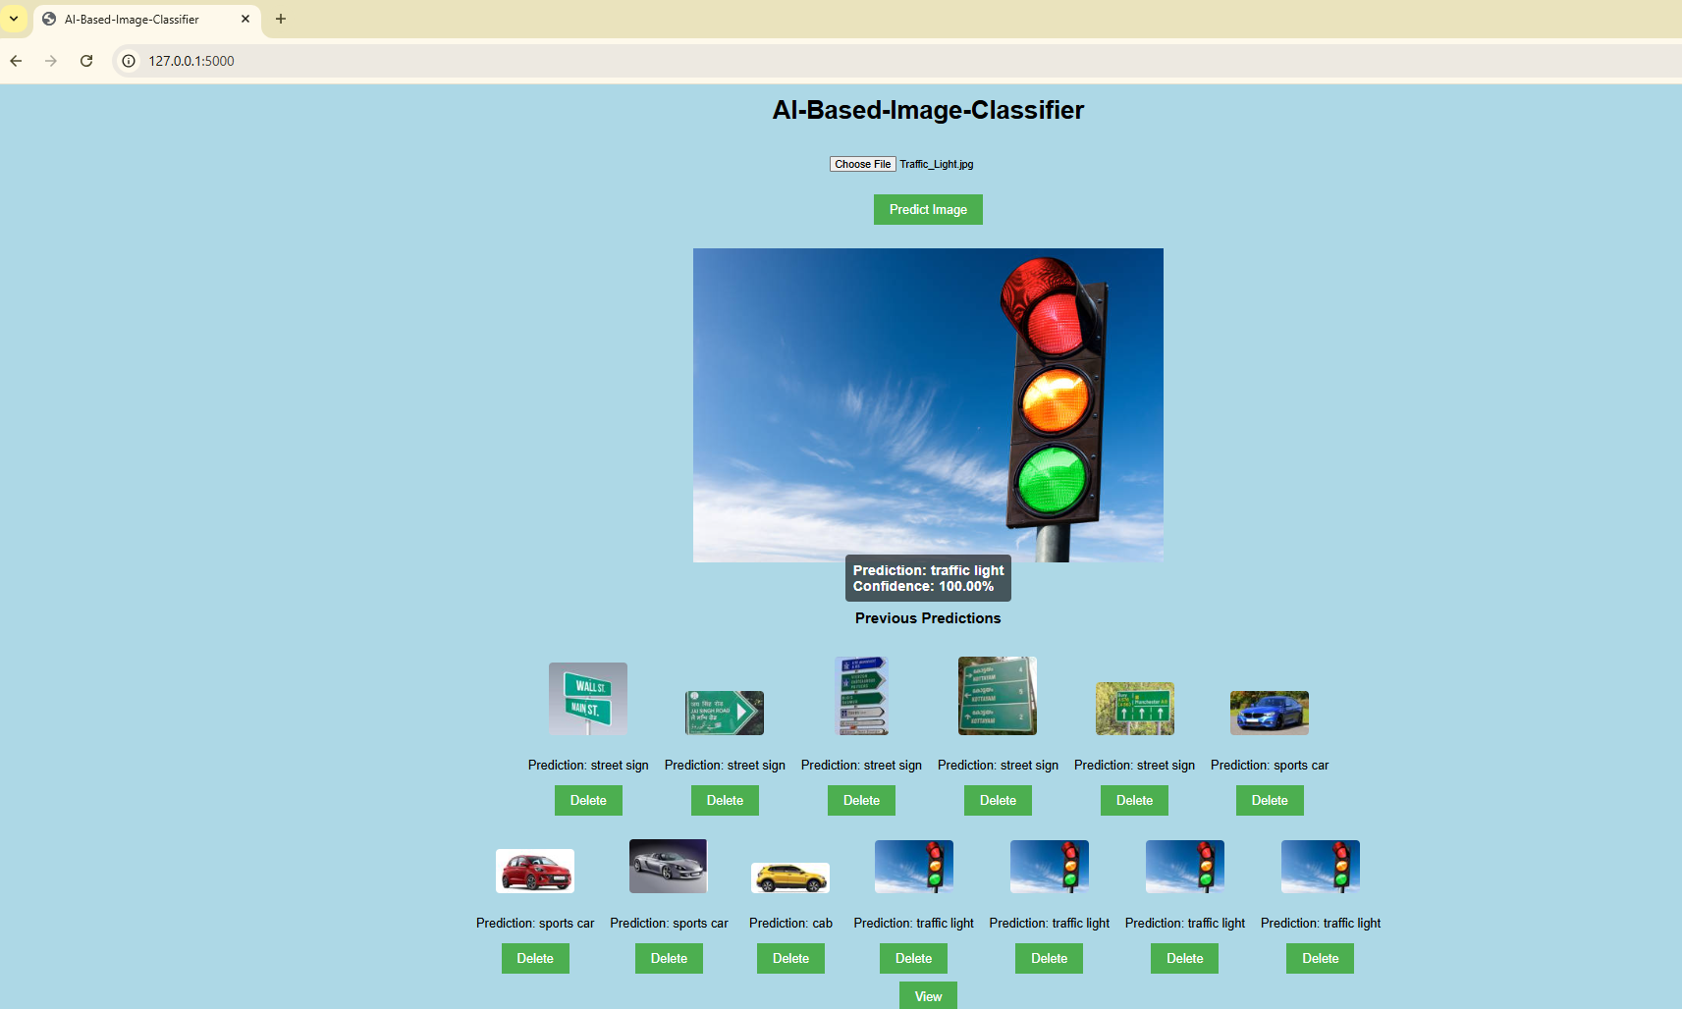
Project Pages: View Previous Predictions:

Slide 13
Future Scope
Enhanced Prediction Models
User Authentication and Authorization
Image Preprocessing and Augmentation
Batch Processing and Bulk Upload
Advanced Analytics and Reporting
Integration with External Services
Mobile Application
Improved User Interface and Experience

Slide 14


Slide 15


